Slide 1


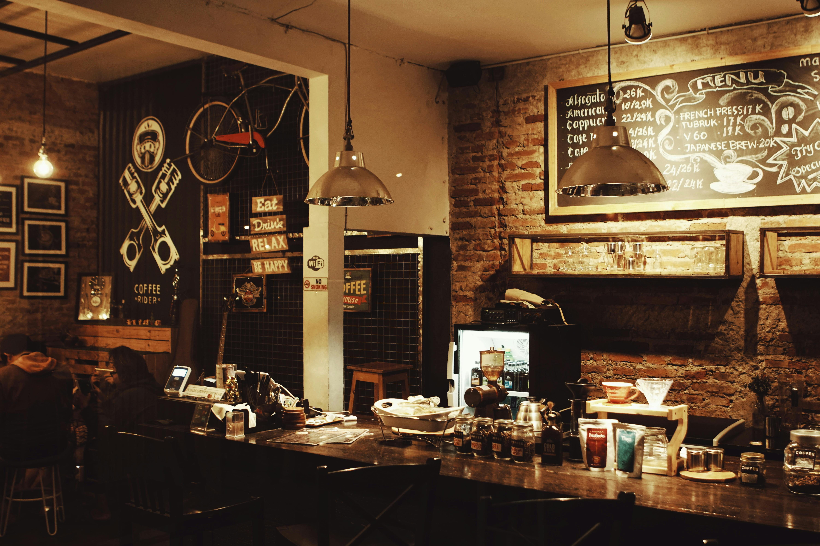

Café Sales
Data Analysis Project
DEPI Graduation Project
1

Slide 2





OUR TEAM
Hager Alaa
Donia Tarek
Mariam Nasr
Mohamed Salah
Hamza elmazahy
Linda Ezzat
2

Slide 3

Introduction
This project aims to analyze sales data to gain meaningful insights and support data-driven decisions.
The dataset includes sales, profit, product, and market details for two years.
3

Slide 4
Dataset Overview
The dataset includes café sales records from various U.S. locations
between 2010 and 2011.
It contains 4,248 rows and 20 columns covering financial, product, regional,
and time-based information.
Key fields: Actual/Budgeted Sales & Profit, Product Type, Product Name, State,
Market Size, and Date.
The data enables multi-dimensional analysis of sales trends, profitability,
and regional performance.
4

Slide 5

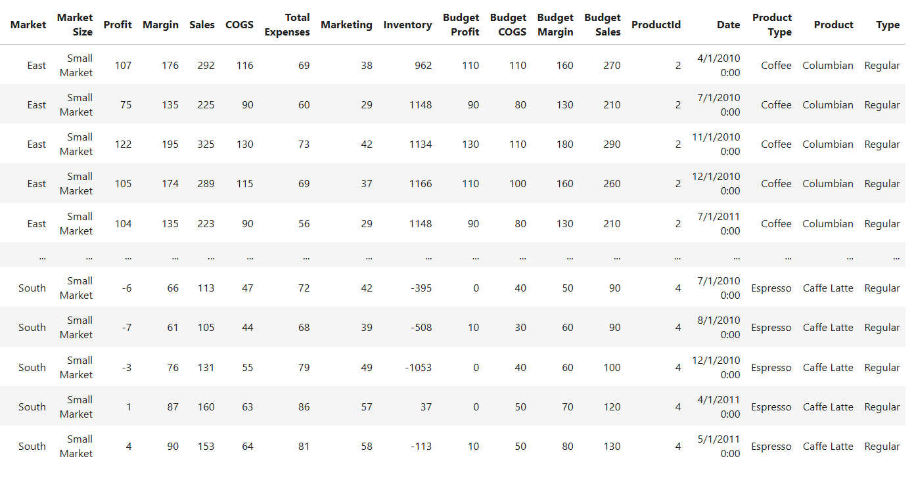
Dataset Overview
5

Slide 6
Dataset Dictionary
6

Slide 7
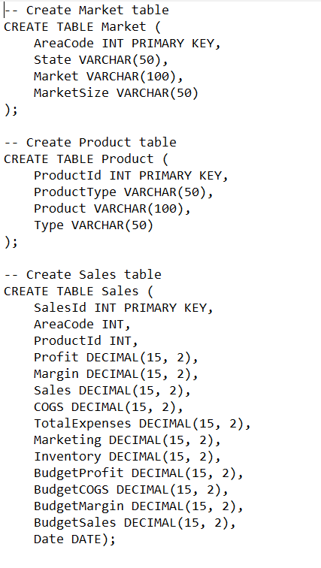
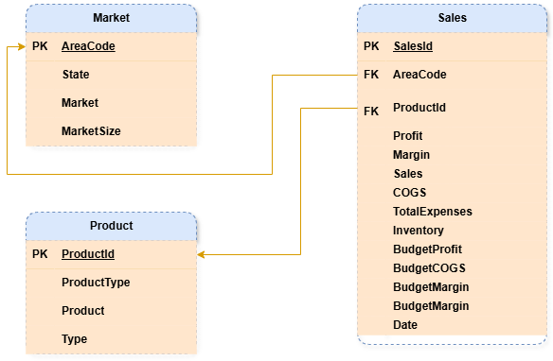
Data Structure
3

Slide 8




Milestones
Data Extraction
Exploring Data
Manipulation & Cleaning
Visualization
3

Slide 9


Dataset Analysis
Product Sales & Profit Overview Top Performer: Colombian Coffee Sales Volume: 128K$ Monthly Profit: 55K$ Colombian Coffee leads the market due to its alignment with American taste and consumption habits larger servings, smooth flavor, and daily usage. Lowest Sales: Regular Espresso Despite being popular in Europe, espresso has limited appeal in the USA where consumers prefer larger, milder coffee drinks like lattes and cappuccinos. Lowest Profit: Green Tea Monthly Profit: -231$ Although not the lowest in sales, Green Tea's high production and supply costs heavily impact its profitability.
3

Slide 10
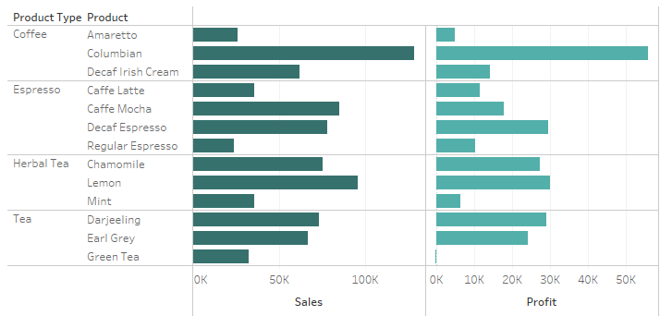
Dataset Analysis
3

Slide 11
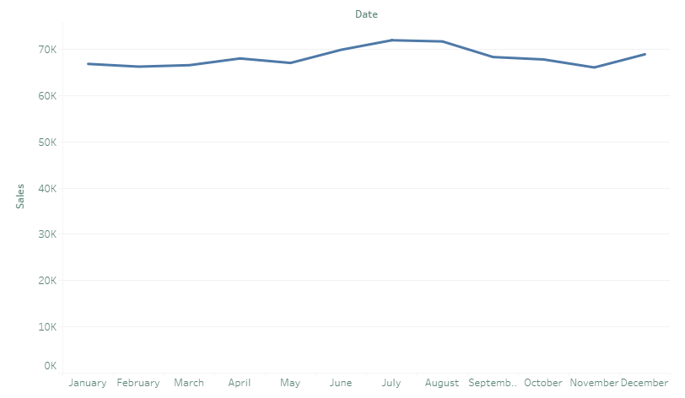
Dataset Analysis
Seasonal Trends
A noticeable increase in sales occurs during July, which coincides with Independence Day (July 4th).
This suggests that holidays and seasonal celebrations significantly influence consumer behavior and provide key opportunities for targeted marketing.
3

Slide 12
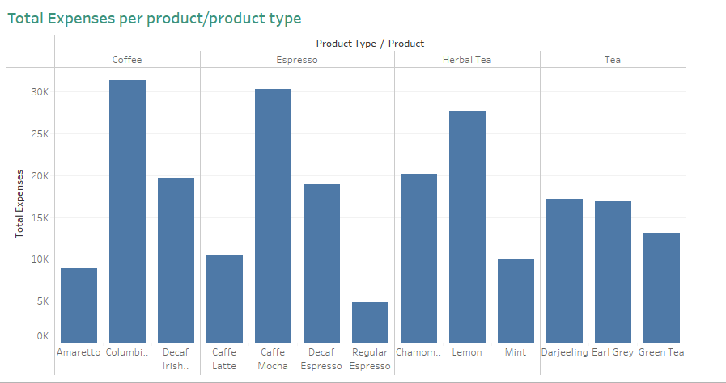
Dataset Analysis
Cost Structure and Margins
Regular Espresso benefits from a lean cost structure—lower production costs help sustain margins despite limited sales.
Green Tea, on the other hand, suffers from high expenses (approx. $13,100/month), undermining any revenue generated.
Product profitability is directly tied to expense management and pricing strategy.
3

Slide 13

Dataset Analysis
Cultural Insights & Consumer Behavior
Espresso is typically consumed quickly in European cultures, often as a single concentrated shot.
American coffee culture prioritizes volume and duration—consumers prefer beverages they can sip throughout their commute or working.
Tea particularly green tea, does not carry the same cultural weight in the US as it does in Asian or Middle Eastern regions. As a result, demand is lower and less consistent.
3

Slide 14

Dataset Analysis
Strategic Recommendations
Expand the Coffee Line Develop new variants (e.g., flavored coffees, iced versions, sustainable packaging).
Invest in targeted marketing campaigns focusing on American lifestyle and preferences.
Launch seasonal promotions and customer loyalty programs to drive repeat purchases.
Revitalize Green Tea
Run educational campaigns highlighting the health benefits of green tea (antioxidants, metabolism boost, etc.).
Introduce new flavors (e.g., mint, honey, lemon) to appeal to a wider demographic.
Redesign packaging for modern appeal and optimize sourcing to reduce cost
3

Slide 15
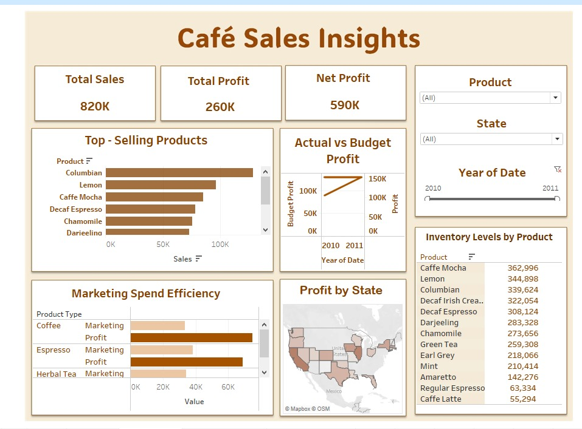
Dashboard
3

Slide 16
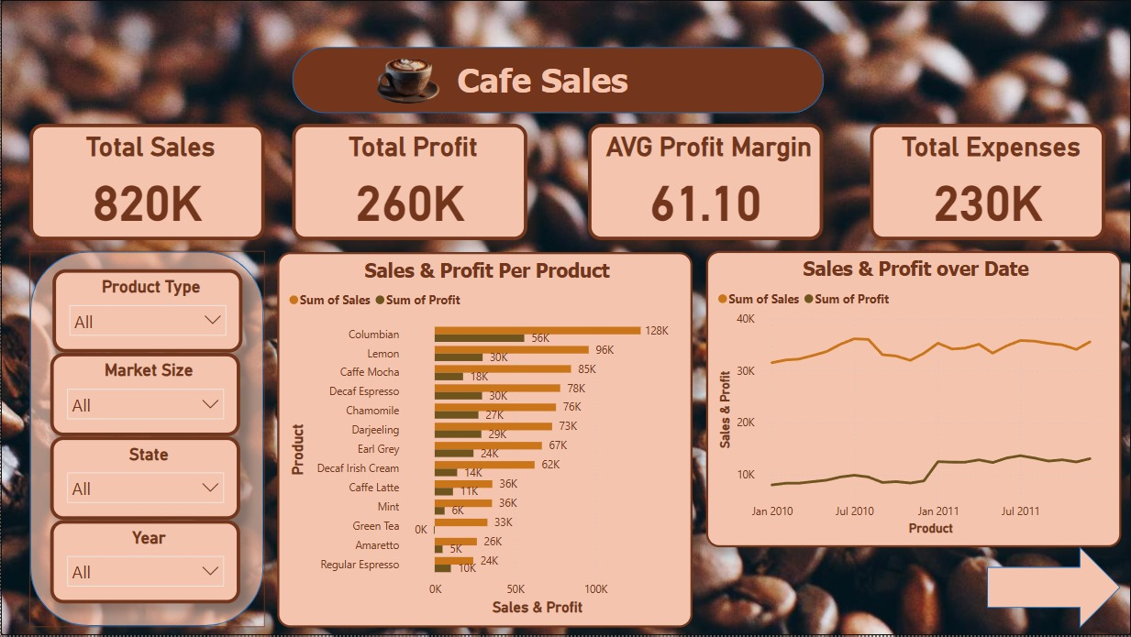
Dashboard
3

Slide 17
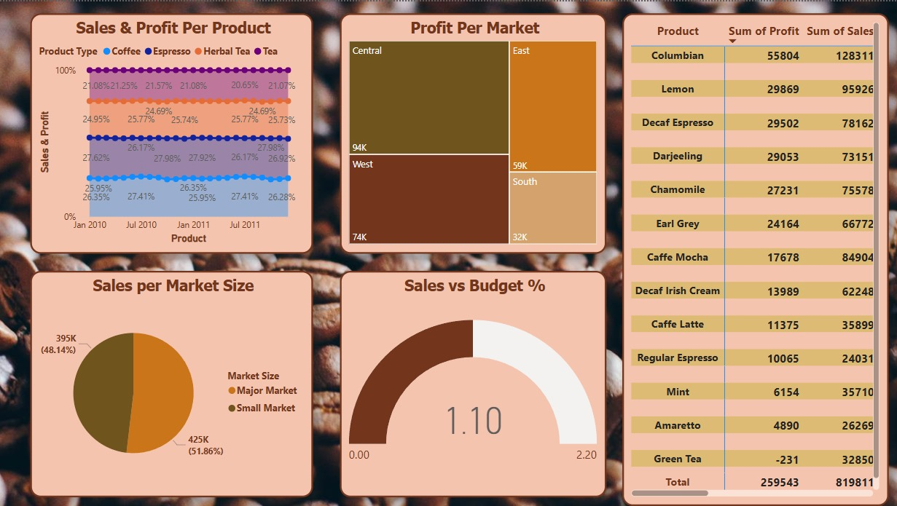
Dashboard
3

Slide 18
Thank you
3

